Slide 1









Whiteboardmaths.com
7
2
1
5
© 2004 All rights reserved

Slide 2

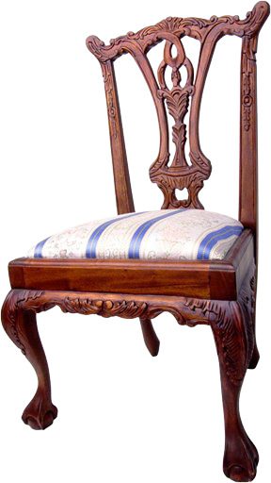
Profit
Percentage Profit and Loss
An antique dealer buys a chair for £250 and sells it for £300. Find the percentage profit that she made on the sale.
Buying Price
£250
£300
Selling Price
Profit = £300 - £250
= £50
profit
Percentage profit =
x 100
buying price
50
Percentage profit =
x 100 = 20%
250

Slide 3

Percentage Profit and Loss
The Robinsons bought their house for £180 000 and sold it 3 years later for £230 000. Find the percentage profit that they made on the sale.
Profit =
£230 000 - £180 000
= £50 000
Buying Price
£180 000
Selling Price
£230 000
profit
Percentage profit =
x 100
buying price
50 000
Percentage profit =
x 100 = 27.8%
180 000

Slide 4






Percentage Profit and Loss
A large store buys goods in bulk at a wholesale price and make a profit by selling them to the public at the retail price. The wholesale price and retail price for some of its goods are shown below. Find the percentage profit made on each item. (1 dp)
£90
£600
£300
£98
£640
£330
8
40
30
x 100 = 8.9%
x 100 = 6.7%
x 100 = 10%
90
600
300
£20
£6.20
£44
£24
£8.10
£50
4
1.90
6
x 100 = 20%
x 100 = 30.6%
x 100 = 13.6%
20
6.20
44

Slide 5

Loss
Percentage Profit and Loss
Simon’s parents bought him a guitar for Christmas. He takes guitar lessons after Christmas but doesn’t really get on too well so he decides to sell it through the local paper. Find the percentage loss for the buying and selling prices shown. (to 1 dp)
Buying Price
£140
£100
Loss = £140 - £100
= £40
Selling Price
loss
Percentage loss =
x 100
buying price
40
Percentage loss =
x 100 = 28.6%
140

Slide 6

Percentage Profit and Loss
Clare bought an expensive car for £28 000 and sold it 3 years later for £15 000. Find the percentage loss that she made on the sale. (1 dp)
Loss =
£28 000 – £15 000 = £13 000
Buying Price
£28 000
Selling Price
£15 000
loss
Percentage loss =
x 100
buying price
13 000
Percentage loss =
x 100 = 46.4%
28 000

Slide 7

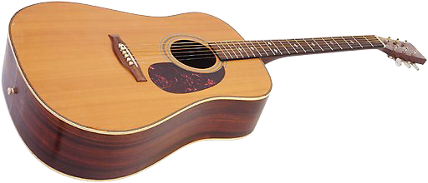
Percentage Profit and Loss
The Smith family are moving house and have decided to have a car boot sale to sell some items that they don’t wish to take with them. The original prices and selling prices for 6 items are shown below. Find the percentage loss in each case. (1 dp)
£20
£10.00
£50
£8
£2.00
£12
12
8
38
x 100 = 60%
x 100 = 80%
x 100 = 76%
20
10
50
£65
£80
£350
£20
£100
£25
45
55
250
x 100 = 69.2%
x 100 = 68.8%
x 100 = 71.4%
65
80
350

Slide 8
Worksheet 1
Percentage Profit and Loss
A large store buys goods in bulk at a wholesale price and make a profit by selling them to the public at the retail price. The wholesale price and retail price for some of its goods are shown below. Find the percentage profit made on each item.
£90
£600
£300
£98
£640
£330
£20
£6.20
£44
£24
£8.10
£50

Slide 9
Worksheet 2
Percentage Profit and Loss
The Smith family are moving house and have decided to have a car boot sale to sell some items that they don’t wish to take with them. The original prices and selling prices for 6 items are shown below. Find the percentage loss in each case. (1 dp)
£20
£10.00
£50
£8
£2.00
£12
£65
£80
£350
£20
£100
£25

